Slide 1

IPL FANTASY LEAGUE
PROJECT MEMBERS:
BEEVI FATHIMA
NISHI J I SANGAMIRTHAM
SHARFUNNISA SHAIK
BANDHA ALEKHYA
SANKARI K

Slide 2
CONTENTS
Problem Statement
Project Structure
Introduction
Developed Using Spring Boot
Used Dependency Jar
Class Diagram
Use Case Diagram
* Admin
*User
Swagger Details
*Admin
*User
Conclusion

Slide 3
PROBLEM statement
IPL Fantasy League System is a web based application for bidding.
Basically this application will have two types of users namely, admin and bidder. Both users have their own set of authorities to use the application. This system should all a new users to register themselves and use all the authorized functionalities. A bidder can sign in with the help of email-id. Bidders can get all the match schedules and he/she will be able to bid on a team in a match before the start of the match using the application. The application shows the match details which includes the playing team Admin is responsible for scheduling and rescheduling of matches. When bidders bid on a match the admin should be able to view all the bidders bidding on a particular team.

Slide 4
INTRODUCTION
Indian Premier League (IPL)
Fantasy League is a virtual game where players create their own team of real-life IPL cricketers and earn points based on their on-field performance. The objective of the game is to outscore other players and become the champion of the league. The application provides an easy-to-use interface where users can create, join or participate in private or public leagues, make transfers, and monitor their team's progress. Players can also earn Points based on their overall rank in the league. IPL Fantasy League provides a unique and exciting way for fans to engage with the sport and adds an extra layer of excitement to the real-life matches.

Slide 5
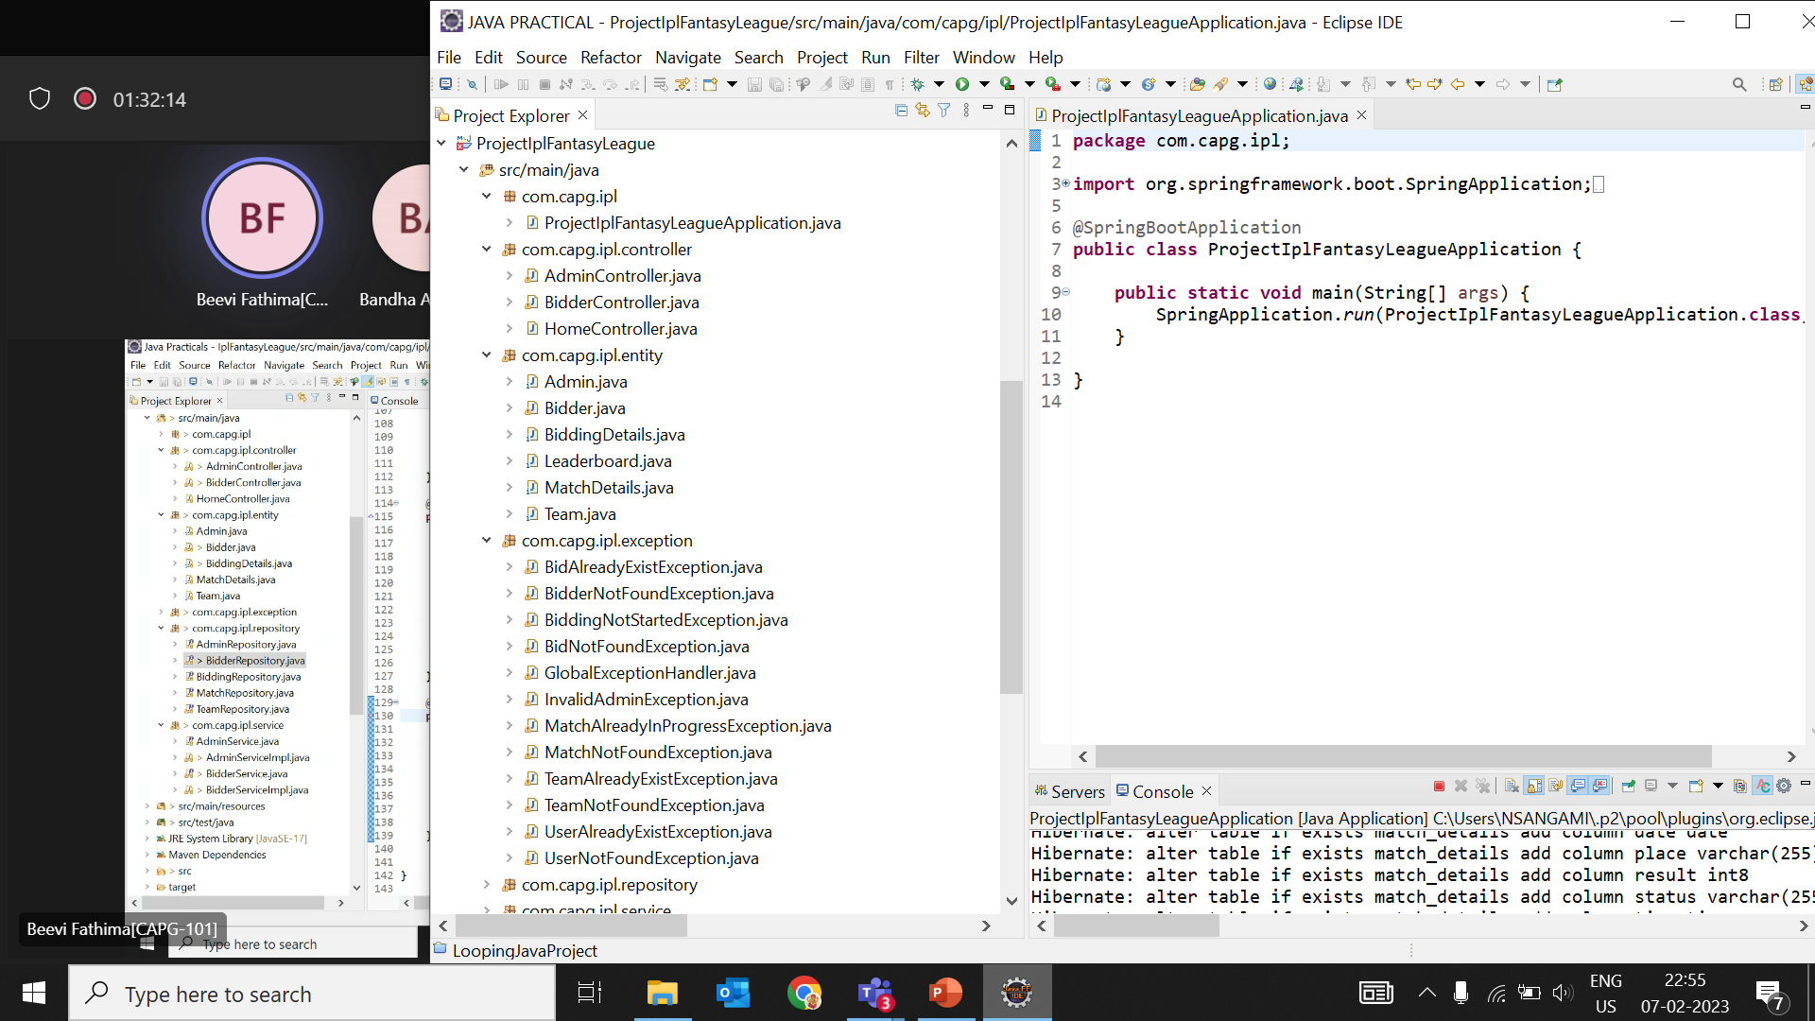
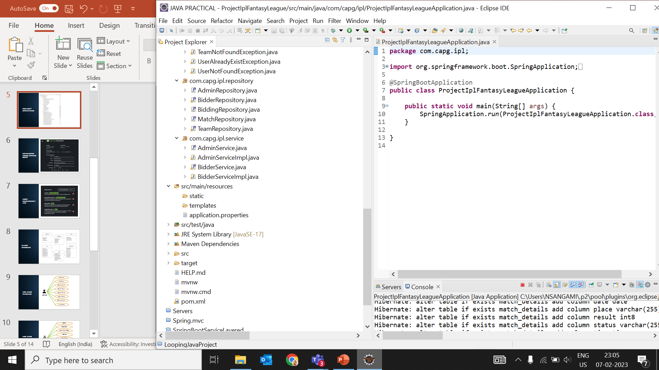
PROJECT STRUCTURE

Slide 6
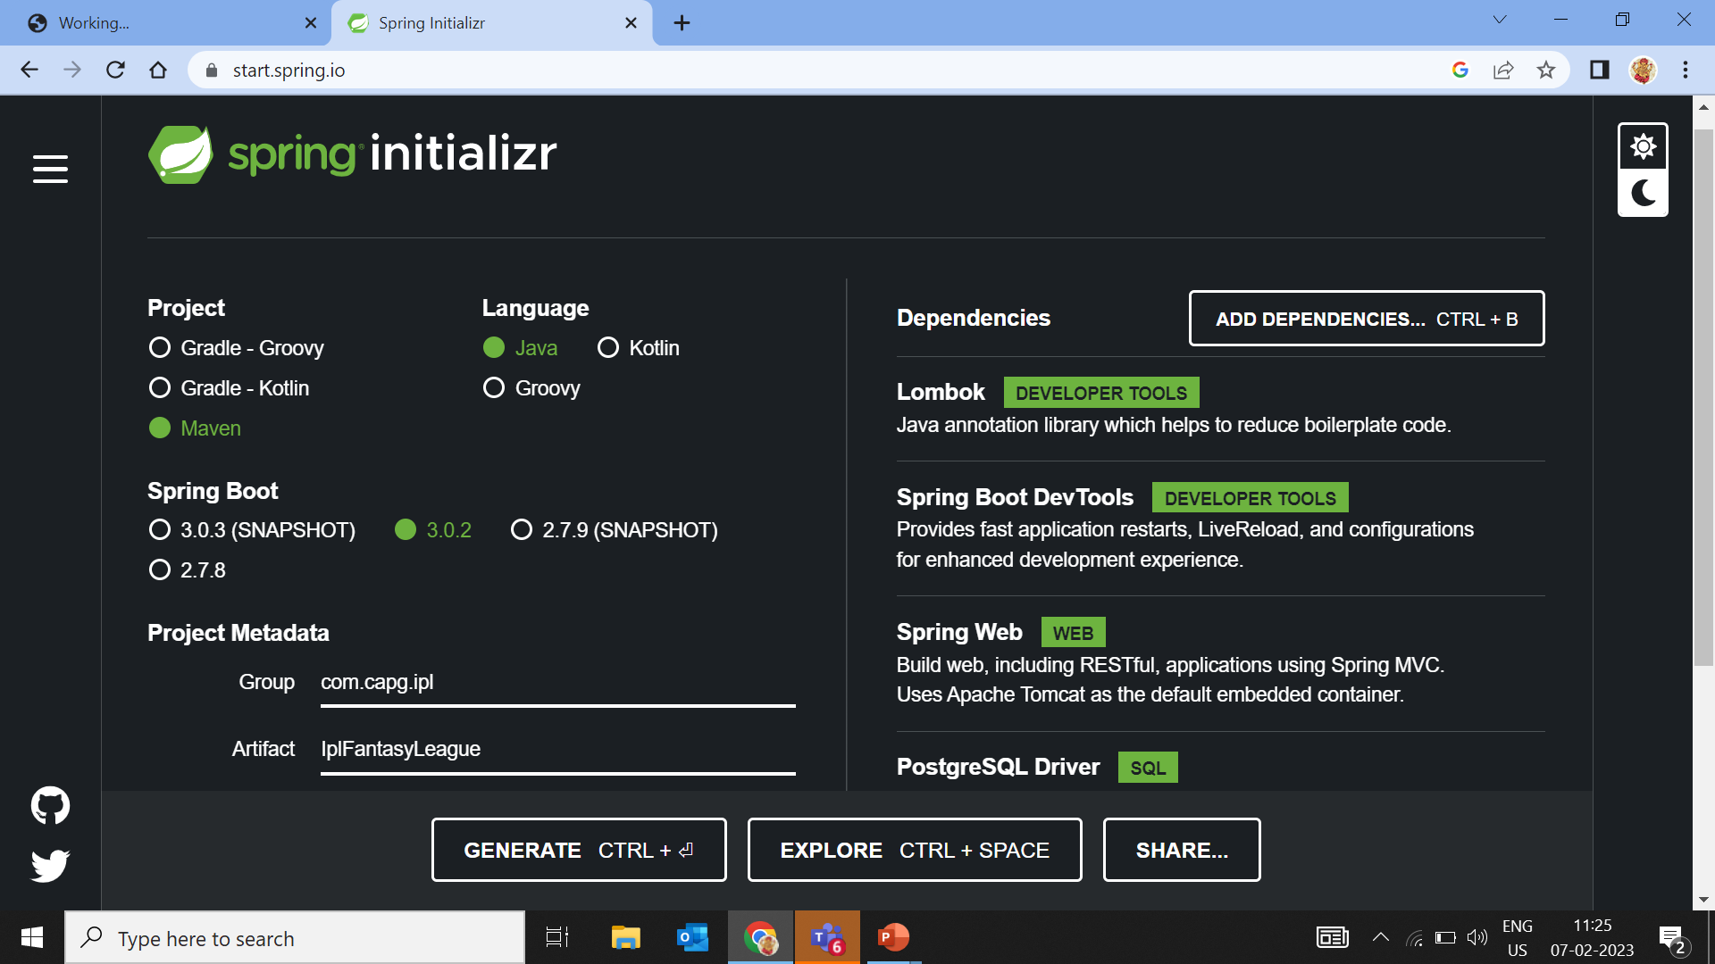
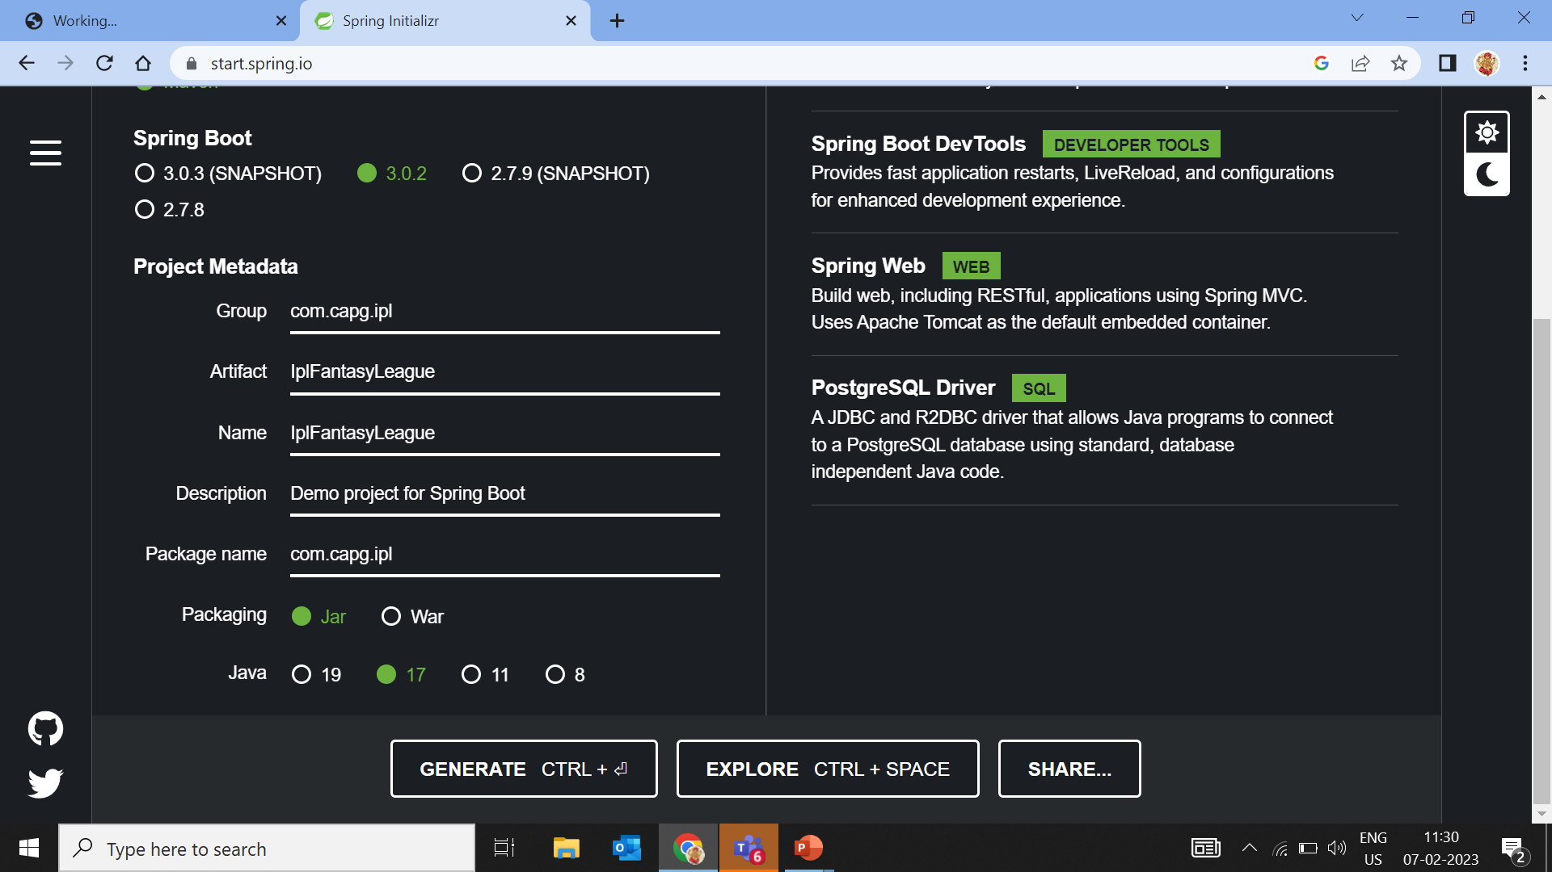
DEVELOPED USING SPRING BOOT

Slide 7
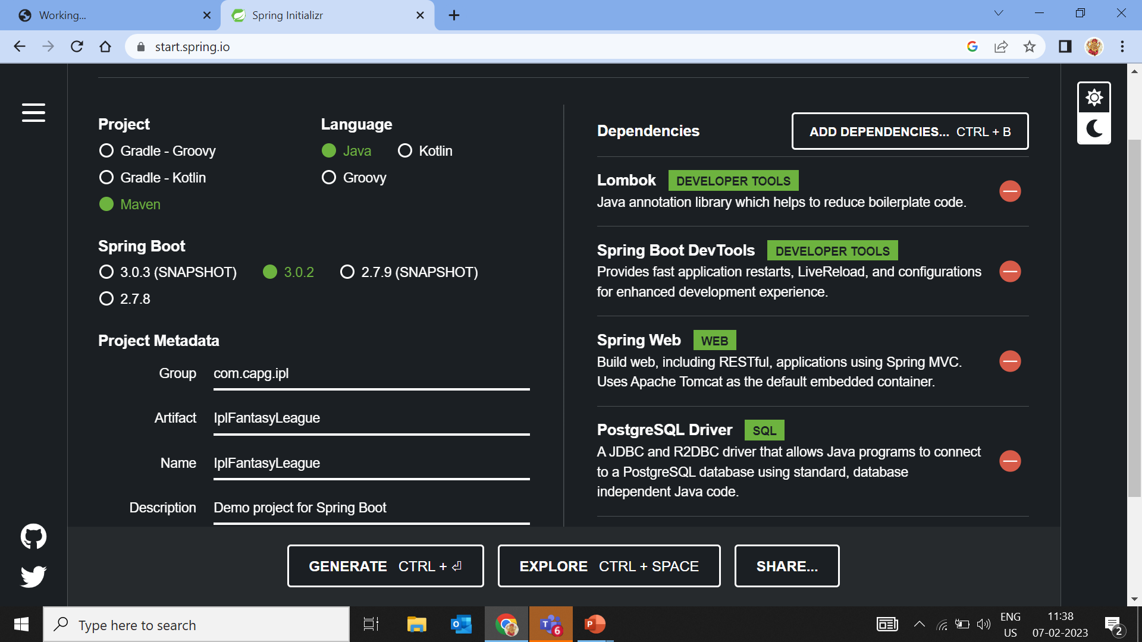
USED DEPENDENCY JAR

Slide 8
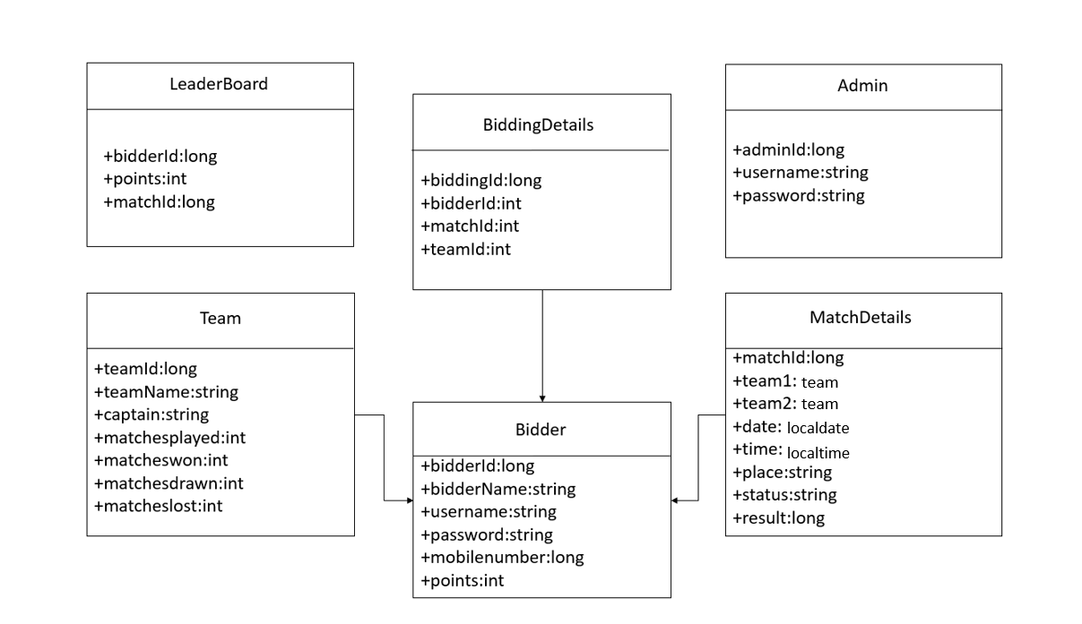
CLASS diagram
team

Slide 9

Use case diagram
Add Match
Add Team
Delete Match
Delete Team
Update Match
ADMIN
Update Score
Declare Result
View Bidder

Slide 10

USE CASE DIAGRAM
LOGIN
REGISTER
VIEW ALL MATCH
ADD BID
UPDATE BID
USER
DELETE BID
VIEW POINTS
GET RESULT
VIEW LEADER BOARD

Slide 11
Swagger input
ADMIN :
http://localhost:8080/admin/login
http://localhost:8080/admin/team
http://localhost:8080/admin/team/teamId
http://localhost:8080/admin/match
http://localhost:8080/admin/matchId
http://localhost:8080/admin/result/matchId/teamId
http://localhost:8080/admin/finale

Slide 12
SWAGGER INPUT
BIDDER :
http://localhost:8080/bidder/login
http://localhost:8080/bidder/register
http://localhost:8080/bidder/bidding
http://localhost:8080/bidder/updateBid
http://localhost:8080/bidder/deleteBid
http://localhost:8080/bidder/result
http://localhost:8080/bidder/all matches

Slide 13
CONCLUSION
In conclusion, the Indian Premier League (IPL) fantasy league is a unique and engaging way for fans to experience and participate in the IPL in a new and exciting way. By picking their own virtual teams and competing against other fans, participants can use their knowledge and understanding of the game to create a truly personal and enjoyable experience. The IPL fantasy league has grown in popularity over the years, attracting fans from around the world and providing a platform for fans to come together and connect over their shared love of cricket. With the IPL set to continue to be a major event in the world of cricket, the IPL fantasy league will likely continue to grow in popularity, providing fans with endless opportunities for fun, excitement, and competition.

Slide 14
THANK YOU

